Slide 1
GAHCHO KUÉ MINE - 2024 WINTER ROAD CARRIER ORIENTATION
[OFFICIAL]
December 2023
PUBLIC

Slide 2
1 GK WR SAFETY SHARE

Slide 3
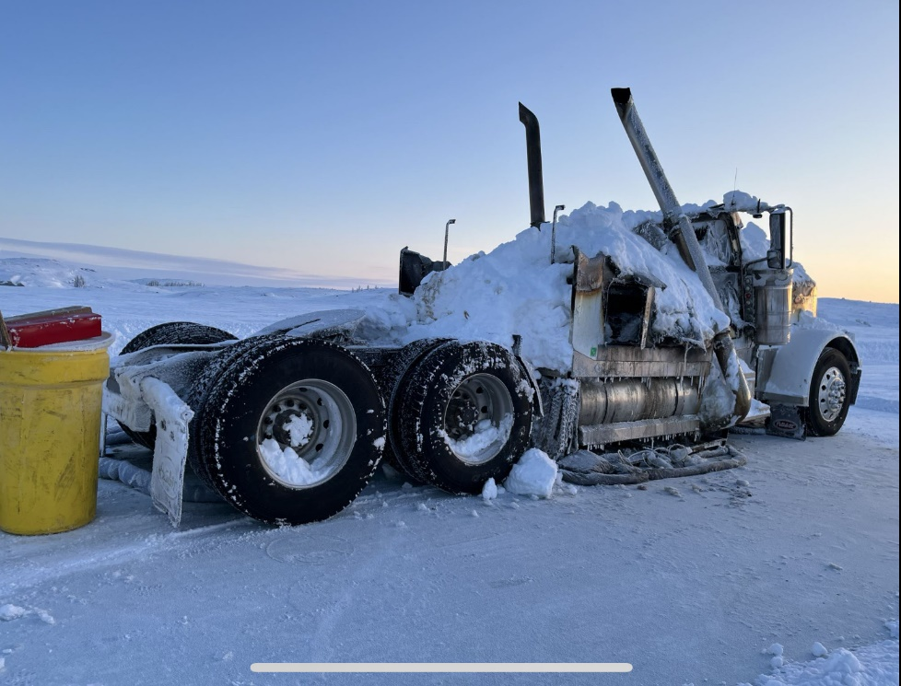
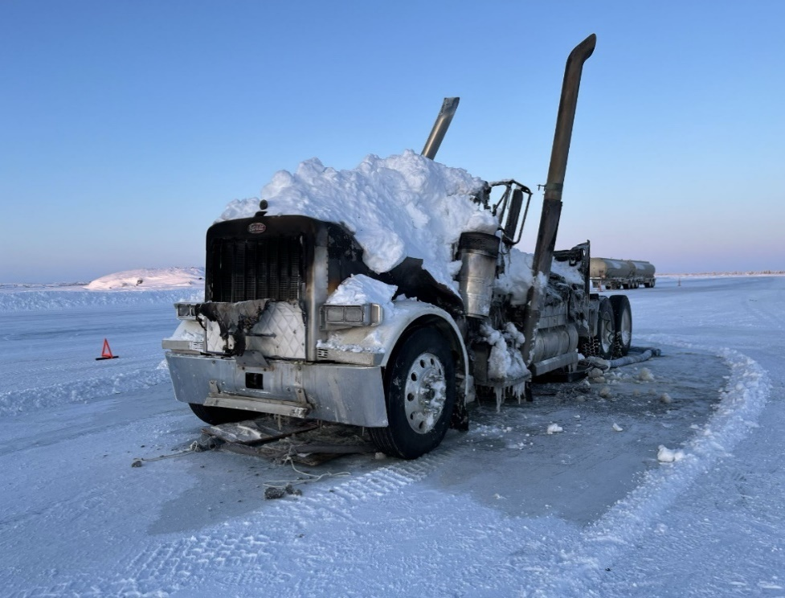
Safety share
Truck Fire on GK Spur Road
GK

Slide 4
Incident description
On Feb 26, 2023, with temperature of -35 and winter road 20 hours away from being shut down due to incoming storm, at approximately 19:20, 200 meters northbound from P11 on Munn Lake, Winter Road fuel truck U0687, (2006 Conventional Peterbilt) caught fire in the engine bay.
Driver called Fire on LADD 2 and attempted to extinguish fire. Nuna loader operator who was maintaining the spur road arrived on scene and smothered fire with snow.
At 20:29 Security called ERT coordinator and advised of WR Truck fire. Coordinator gathered ERT team for a response with AARF and requested permission from Acting Weekend Duty Manager to respond off site.
WDM and ERT Coordinator met and additional information was gathered from SCM Supervisor which indicated that Nuna had responded, extinguished the fire, driver was “ok” and on way back to Yellowknife with teammate. ERT stood down.
Cause was investigated by owner/operator indicates suspected electrical fire in the engine bay.

Slide 5
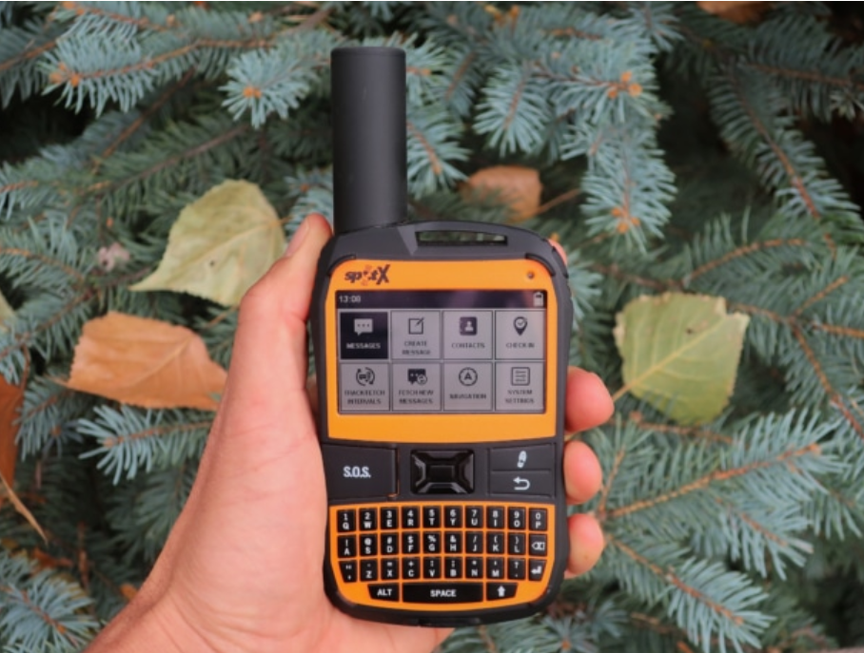
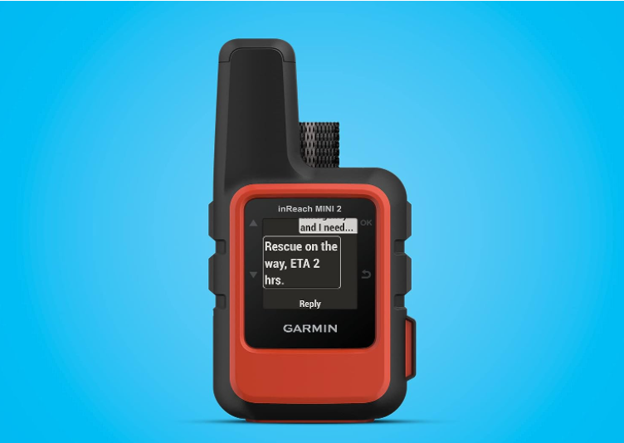
Spot X
InReach
Notes:
Bluetooth 2-Way Satellite Messenger | SOS Protection | Handheld Portable 2-Way GPS Messenger | Globalstar Satellite Network Coverage

Slide 6
GPS Devices for Carriers, Hunters & Ice Road Users
The Importance of GPS Devices for Carriers, Hunters & Ice Road Users
Emergency Communication: Enables instant two-way communication in remote areas, enhancing safety by providing a lifeline in emergencies.
SOS Alerts: Equipped with SOS features, allowing quick distress signal transmission and prompt response during critical situations, prioritizing safety.
Real-time GPS Tracking: Provides accurate location monitoring, aiding in navigation and ensuring that truckers’ whereabouts are known, contributing to overall safety.
Remote Area Coverage: Operates in locations with limited or no cell coverage, ensuring consistent communication and safety features even in isolated icy environments.
Enhanced Emergency Response: Facilitates a faster and more effective emergency response, crucial for dealing with accidents or unforeseen challenges on hazardous ice roads.
Peace of Mind: Truckers have the assurance of reliable communication and emergency capabilities, promoting a safer work environment and reducing potential risks associated with the unpredictable nature of ice road trucking.

Slide 7
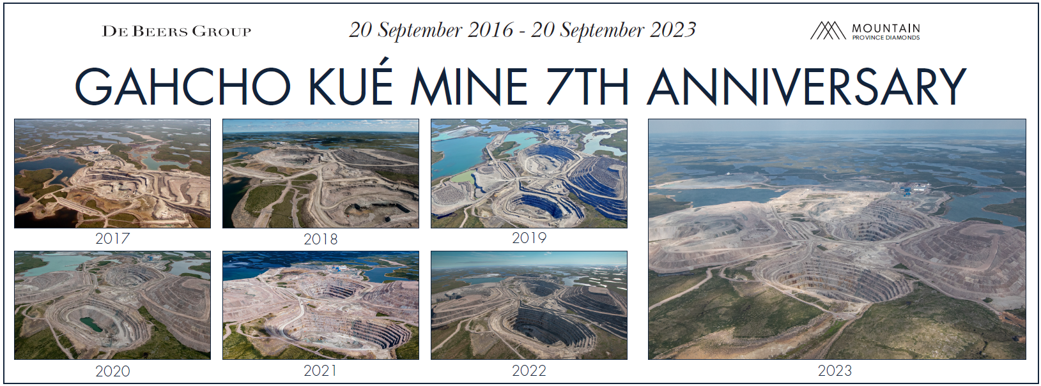
SEVEN YEARS IN PRODUCTION
Notes:
Pleased to provide this update on Gahcho Kué Mine
We marked seven years of operation in September and as you can see, the mine continues to change as operations advance
Our current life of mine is to 2030

Slide 8
Avischen Moodley - COUNTRY PRESIDENT
New role effective November 1, 2023
Served as Chief Financial Officer for De Beers Group Managed Operations from 2019 – based in Johannesburg, SA
Served in multiple roles with Anglo American plc Group from 2009
Holds a Bachelor of Business Science (Actuarial Science), is a fellow of the Institute of Actuaries, specializing in Finance and Investment and is qualified as a Chartered Financial Analyst
Based out of the Calgary Support Centre

Slide 9
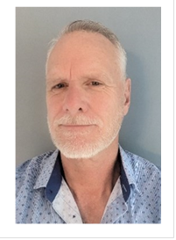
Gerry rogers – mine general manager, Gahcho kuÉ
Appointment effective November 9, 2023
Comes to Gahcho Kué from Moneta Gold Inc. where he was responsible for bringing the company’s Tower Gold Project into production
Previous roles include General Manager at Baffinland Iron Ore Mines, Operations Manager at Chirano Gold Mines, Vice President Operations at Compass Minerals Canada and many other leadership roles at underground and open pit mines in Canada, the United States and Western Australia

Slide 10
Jason Snaggs – WAREHOUSE & LOGISTICS SUPERINTENDENT, Gahcho kuÉ
I am pleased to announce the appointment, effective February 6, 2023, of Jason Snaggs to the position of Warehouse & Logistics Superintendent at Gahcho Kué mine, reporting to myself.
Jason will utilize his extensive experience in supply chain management and operations to lead the supply chain team at GK. Jason has worked for Meta-Labs(Facebook), the Government of the Northwest Territories, Celestica, other organizations including a couple of years at the Snap Lake mine during its operations.
Jason comes to De Beers with an engineering degree, as well as a master’s degree in Business Administration. A resident of Yellowknife, he will work a 4x3 rotation at the mine.
Please join me in welcoming Jason back to the De Beers team.
Cameron Warren, Supply Chain Manager

Slide 11
GK Planned Freight & Fuel
2024

Slide 12
KEY WR 2024 Key Changes & OBJECTIVES
Key Lesson Learned from WR 2023:
350,000 lbs of freight did not make it on 2023 Winter Road.
Earlier Start to 14 Month Pre-Planning Material and Assets based on our Mine Plan
Earlier Start to Procurement – 90% PO’s Issued August – October
Pre-Staging in Yellowknife DCL and Grimshaw before January 30th
Staging has begun at DCL and Metshaw laydowns
Sea Cans will be used for the rotation of freight to minimize vans.
Focus on “Rules of the Road” & Equipment Reliability.
Notes:
The key focus going forward is to drive continuous and operational excellence in on Winter Road Operations from planning to execution based on lessons learned.
We Can’t Improve What We Can’t Measure

Slide 13
KEY WR 2024 Key Changes & OBJECTIVES
Key Performance indicators (KPIs) for measuring the success of the 2024 Winter Road:
SAFETY
Zero Safety/Accident Incidences
Zero Spills
Zero Speeding Incidences
100% Compliance Safety and Government Regulations
EFFICIENCY
95% On-Time-Delivery
95% Logistics & Handling Efficiency
Carrier Equipment Reliability Incidences
WR Planned Vs. Actual Deliveries
Notes:
The key focus going forward is to drive continuous and operational excellence in on Winter Road Operations from planning to execution based on lessons learned.
We Can’t Improve What We Can’t Measure

Slide 14
2024 Planning vs 2023 Winter – Advanced Planning
14 Month Winter Road Planning
Key Milestones:
 | 14 Month WR Milestones | Month
1 | Capital Asset Purchase requisitions issued as soon as approved | Immediate
2 | Draft Mine Plan | May
3 | Initial WR Forecast by department completed in collaboration with Inventory Planners, WH Co-ordinators and Department planners | June
4 | Initial WR Backhaul Forecast by department completed in collaboration with Inventory Planners, WH Co-ordinators and Department planners | June
5 | Draft WR Forecast issued to HODs and Supervisors and Planners to review and approve with Finalized Mine Plan first 2 Weeks of July | Wk 1 & 2 July
6 | Draft WR Backhaul Forecast issued to HODs and Supervisors and Planners to review and approve with Finalized Mine Plan first 2 Weeks of July | Wk 1 & 2 July
7 | Consolidated WR Inventory & Backhaul Forecast Approved by GM | End July
8 | WR POs Issued, Fuel, Hydrocarbons, Inventory | Wk 1 August
9 | WR Backhaul Asset and Inventory Disposal Paperwork (Bims, Weights, etc.) completed and staging begins | Wk 1 August
 | Winter Road Prep & Checks (Labour Planning, Facilities, IT, Radio, Equipment, etc.) | September
10 | 95% WR Load Consolidation | December
11 | Spur Road Construction | December
12 | JV Winter Road Construction | December
13 | WR Start | February
14 | WR End | End March

Slide 15
GK ESTIMATED lOADS CURRENT Status
PREDICTED TONNAGES & ESTIMATED LOADS
2024 WINTER ROAD (as of November 6, 2023)
Description | Gahcho Kue
Fuel (Diesel)
Litres | 49
Loads | 1,125
Tonnes | 40,670
Other/General Freight & Equip
Loads | 352
Tonnes | 11,616
Prill
Loads | 226
Tonnes | 8,300
Cement
Loads
Tonnes
Shotcrete
Loads
Tonnes
Backhaul Loads
Loads | 132
Tonnes | 2,640
Total Tonnes (Northbound only) | 60,586
Total Tonnes (North & South) | 63,226
Total Loads (Northbound only) | 1,703
Total Loads (North & South) | 1,835
% of Tonnage
# of loads that are heavy or oversize | 10
KM
Total estimated loads – 1,835 Loads
Fuel - 1,125 Loads
Freight – 710 Loads
Total Tonnage North and South – 63, 226 Tons
Status update:
Supply Chain has issued 368 PO lines for Material arriving on Winter Road
Overall Value of Winter Road PO’s is $31.4M excl., this includes a WA900 Loader at $2.7M

Slide 16
Seasonal Trends – jv Ice Thickness
Minimum ICE THICKNESS INCREASES in CM
DATE | 2002 | 2003 | 2004 | 2005 | 2006 | 2007 | 2008 | 2009 | 2010 | 2011 | 2012 | 2013 | 2014 | 2015 | 2016 | 2017 | 2018 | 2019 | 2020 | 2021 | 2022 | 2023 | 21 Years Average | 7 yea average | 21 years (Excl. zero) | 7 year (Excl. zero) | 5 year (Excl. zero) | Proposed
25-Jan | - | - | - | - | - | - | - | - | - | - | - | - | - | - | - | - | 66
26-Jan | - | - | - | - | - | 69 | - | - | - | - | - | - | - | - | - | - | 66
27-Jan | - | - | - | - | - | 69 | - | - | - | - | - | - | - | - | - | - | 66
28-Jan | - | - | - | - | - | 69 | 71 | - | - | - | - | - | - | - | - | - | 76
29-Jan | 74 | - | - | - | - | 69 | 71 | - | - | 74 | - | - | - | 81 | - | - | 81 | 74 | 71 | - | - | - | 27 | 32 | 74 | 75 | 73 | 75
30-Jan | 74 | - | 71 | - | - | 69 | 71 | - | - | 74 | - | 86 | 76 | 81 | - | - | 81 | 74 | 71 | - | - | - | 38 | 32 | 75 | 75 | 73 | 75
31-Jan | 74 | - | 71 | 69 | - | 71 | 71 | - | - | 79 | - | 86 | 79 | 86 | - | - | 84 | 79 | 71 | - | 78 | - | 45 | 45 | 77 | 78 | 76 | 77
1-Feb | 76 | 69 | 71 | 69 | - | 71 | 76 | 74 | - | 84 | 71 | 91 | 79 | 86 | - | 71 | 84 | 81 | 73 | - | 78 | - | 59 | 55 | 77 | 77 | 77 | 77
2-Feb | 76 | 69 | 71 | 76 | - | 71 | 76 | 74 | - | 84 | 71 | 97 | 79 | 89 | - | 76 | 84 | 81 | 73 | - | 81 | - | 60 | 56 | 78 | 79 | 78 | 79
3-Feb | 76 | 71 | 76 | 76 | - | 76 | 76 | 79 | - | 84 | 74 | 97 | 84 | 89 | - | 76 | 89 | 87 | 78 | - | 81 | - | 62 | 59 | 81 | 82 | 82 | 82
4-Feb | 81 | 71 | 76 | 79 | - | 76 | 76 | 84 | 79 | 89 | 74 | 97 | 84 | 91 | - | 76 | 89 | 90 | 78 | - | 81 | 74 | 70 | 70 | 81 | 81 | 81 | 81
5-Feb | 81 | 71 | 76 | 79 | - | 76 | 76 | 84 | 84 | 89 | 79 | 97 | 84 | 94 | - | 84 | 89 | 90 | 81 | - | 84 | 74 | 71 | 72 | 83 | 84 | 82 | 84
6-Feb | 81 | 71 | 76 | 79 | 66 | 79 | 84 | 84 | 89 | 89 | 79 | 97 | 86 | 97 | - | 84 | 89 | 95 | 81 | - | 84 | 74 | 76 | 72 | 83 | 84 | 84 | 84
7-Feb | 89 | 76 | 76 | 86 | 66 | 79 | 86 | 89 | 89 | 89 | 81 | 99 | 86 | 99 | - | 84 | 94 | 95 | 85 | - | 84 | 79 | 78 | 74 | 86 | 87 | 86 | 87
8-Feb | 89 | 84 | 79 | 86 | 66 | 79 | 89 | 89 | 89 | 91 | 81 | 99 | 91 | 99 | - | 84 | 94 | 99 | 85 | 73 | 94 | 79 | 83 | 87 | 87 | 87 | 86 | 87
9-Feb | 91 | 84 | 79 | 86 | 69 | 79 | 89 | 89 | 91 | 94 | 81 | 99 | 91 | 102 | 66 | 84 | 94 | 99 | 88 | 78 | 94 | 85 | 87 | 89 | 87 | 89 | 89 | 89
10-Feb | 91 | 84 | 79 | 86 | 69 | 81 | 94 | 94 | 91 | 94 | 84 | 99 | 94 | 102 | 71 | 89 | 97 | 99 | 88 | 78 | 94 | 85 | 88 | 90 | 88 | 90 | 89 | 90
11-Feb | 91 | 84 | 79 | 91 | 71 | 81 | 97 | 94 | 91 | 97 | 86 | 104 | 97 | 102 | 71 | 89 | 97 | 99 | 91 | 78 | 99 | 85 | 90 | 91 | 90 | 91 | 90 | 91
12-Feb | 91 | 89 | 89 | 91 | 71 | 86 | 97 | 94 | 91 | 97 | 86 | 104 | 97 | 102 | 76 | 91 | 99 | 99 | 91 | 86 | 99 | 85 | 91 | 93 | 91 | 93 | 92 | 93
13-Feb | 91 | 89 | 89 | 97 | 74 | 86 | 99 | 99 | 91 | 99 | 89 | 104 | 99 | 102 | 76 | 91 | 99 | 99 | 95 | 87 | 99 | 87 | 93 | 94 | 93 | 94 | 93 | 94
14-Feb | 97 | 89 | 89 | 97 | 74 | 91 | 99 | 99 | 94 | 99 | 89 | 104 | 99 | 102 | 79 | 97 | 102 | 99 | 95 | 87 | 99 | 89 | 94 | 95 | 94 | 95 | 94 | 95
15-Feb | 97 | 91 | 89 | 97 | 76 | 91 | 104 | 104 | 94 | 99 | 89 | 104 | 99 | 102 | 79 | 97 | 102 | 99 | 95 | 92 | 99 | 91 | 95 | 96 | 95 | 96 | 95 | 96
16-Feb | 97 | 97 | 89 | 99 | 76 | 91 | 104 | 104 | 94 | 99 | 91 | 104 | 102 | 102 | 84 | 97 | 102 | 104 | 99 | 92 | 99 | 91 | 96 | 98 | 96 | 98 | 97 | 98
17-Feb | 97 | 97 | 91 | 99 | 79 | 94 | 104 | 104 | 94 | 104 | 91 | 104 | 102 | 102 | 84 | 97 | 102 | 104 | 99 | 95 | 103 | 91 | 97 | 99 | 97 | 99 | 98 | 99
18-Feb | 97 | 97 | 91 | 99 | 79 | 94 | 104 | 104 | 94 | 104 | 91 | 104 | 107 | 102 | 84 | 97 | 102 | 104 | 99 | 95 | 103 | 94 | 97 | 99 | 97 | 99 | 99 | 99
19-Feb | 97 | 97 | 94 | 99 | 81 | 97 | 104 | 104 | 94 | 104 | 91 | 104 | 107 | 102 | 86 | 97 | 102 | 104 | 102 | 99 | 103 | 95 | 98 | 100 | 98 | 100 | 101 | 100
20-Feb | 97 | 97 | 94 | 104 | 81 | 97 | 104 | 104 | 94 | 104 | 91 | 104 | 107 | 107 | 89 | 97 | 102 | 104 | 102 | 99 | 103 | 99 | 99 | 101 | 99 | 101 | 101 | 101
21-Feb | 97 | 104 | 97 | 104 | 84 | 97 | 104 | 104 | 97 | 104 | 97 | 104 | 107 | 107 | 89 | 99 | 102 | 104 | 102 | 99 | 103 | 99 | 100 | 101 | 100 | 101 | 101 | 101
22-Feb | 99 | 104 | 97 | 104 | 84 | 99 | 104 | 104 | 97 | 104 | 97 | 104 | 107 | 107 | 89 | 99 | 102 | 106 | 102 | 99 | 103 | 99 | 100 | 101 | 100 | 101 | 102 | 101
23-Feb | 99 | 104 | 104 | 104 | 86 | 99 | 104 | 104 | 97 | 104 | 97 | 104 | 107 | 107 | 89 | 99 | 102 | 106 | 102 | 99 | 103 | 99 | 101 | 101 | 101 | 101 | 102 | 101
24-Feb | 99 | 104 | 104 | 104 | 89 | 99 | 104 | 104 | 97 | 104 | 97 | 104 | 107 | 107 | 89 | 99 | 102 | 106 | 106 | 99 | 103 | 99 | 101 | 102 | 101 | 102 | 103 | 102
25-Feb | 99 | 104 | 104 | 104 | 89 | 99 | 104 | 104 | 97 | 104 | 99 | 104 | 107 | 107 | 94 | 99 | 102 | 106 | 106 | 99 | 103 | 99 | 101 | 102 | 101 | 102 | 103 | 102
26-Feb | 99 | 104 | 104 | 104 | 91 | 104 | 104 | 104 | 99 | 104 | 99 | 104 | 107 | 107 | 94 | 99 | 102 | 106 | 106 | 102 | 103 | 99 | 102 | 102 | 102 | 102 | 103 | 102
27-Feb | 99 | 104 | 104 | 104 | 94 | 104 | 104 | 104 | 99 | 104 | 102 | 104 | 107 | 107 | 94 | 102 | 102 | 106 | 106 | 104 | 107 | 103 | 103 | 104 | 103 | 104 | 105 | 104
28-Feb | 99 | 104 | 104 | 104 | 94 | 104 | 104 | 104 | 99 | 104 | 102 | 104 | 107 | 107 | 94 | 102 | 108 | 106 | 106 | 105 | 107 | 103 | 103 | 105 | 103 | 105 | 105 | 105
29-Feb | 99 | 104 | 104 | 104 | 94 | 104 | 104 | 104 | 99 | 104 | 102 | 104 | 107 | 107 | 94 | 102 | 108 | 106 | 106 | 105 | 107 | 103 | 103 | 105 | 103 | 105 | 105 | 105
1-Mar | 99 | 104 | 104 | 104 | 97 | 104 | 104 | 104 | 99 | 104 | 104 | 104 | 107 | 107 | 94 | 102 | 108 | 106 | 106 | 105 | 107 | 103 | 103 | 105 | 103 | 105 | 105 | 105
2-Mar | 99 | 104 | 104 | 104 | 97 | 104 | 104 | 104 | 99 | 104 | 104 | 104 | 107 | 107 | 94 | 102 | 108 | 106 | 106 | 105 | 107 | 103 | 103 | 105 | 103 | 105 | 105 | 105
3-Mar | 99 | 104 | 104 | 104 | 97 | 104 | 104 | 104 | 99 | 104 | 104 | 104 | 107 | 107 | 97 | 102 | 108 | 106 | 106 | 105 | 107 | 103 | 104 | 105 | 104 | 105 | 105 | 105
4-Mar | 104 | 104 | 104 | 104 | 97 | 104 | 104 | 104 | 99 | 104 | 104 | 104 | 107 | 107 | 97 | 102 | 108 | 106 | 106 | 105 | 107 | 103 | 104 | 105 | 104 | 105 | 105 | 105
5-Mar | 104 | 104 | 104 | 104 | 97 | 104 | 104 | 104 | 99 | 104 | 104 | 104 | 107 | 107 | 99 | 102 | 108 | 106 | 106 | 105 | 107 | 107 | 104 | 106 | 104 | 106 | 106 | 106
6-Mar | 104 | 104 | 104 | 104 | 99 | 104 | 104 | 104 | 99 | 104 | 104 | 104 | 107 | 107 | 99 | 102 | 108 | 106 | 106 | 105 | 107 | 107 | 104 | 106 | 104 | 106 | 106 | 106
7-Mar | 104 | 104 | 104 | 104 | 99 | 104 | 104 | 104 | 99 | 104 | 104 | 104 | 107 | 107 | 99 | 102 | 108 | 106 | 106 | 105 | 107 | 107 | 104 | 106 | 104 | 106 | 106 | 106
8-Mar | 104 | 104 | 104 | 104 | 99 | 104 | 104 | 104 | 99 | 104 | 104 | 104 | 107 | 107 | 99 | 104 | 108 | 106 | 106 | 105 | 107 | 107 | 104 | 106 | 104 | 106 | 106 | 106
9-Mar | 104 | 104 | 104 | 104 | 99 | 104 | 104 | 104 | 99 | 104 | 104 | 104 | 107 | 107 | 99 | 104 | 108 | 106 | 106 | 105 | 107 | 107 | 104 | 106 | 104 | 106 | 106 | 106
Notes:
Based on the current weather conditions and the seasonal trends for the last 7 years we estimate 2nd week of February. Key Challenges:• Highlight the main challenges your supply chain faces during the winter months, such as snow, ice, storms, and reduced daylight.4. Road Conditions and Safety:• Discuss the state of road conditions and safety measures in place, including any road closures or restrictions.

Slide 17
GK Spur Road & Mine Site
2024

Slide 18
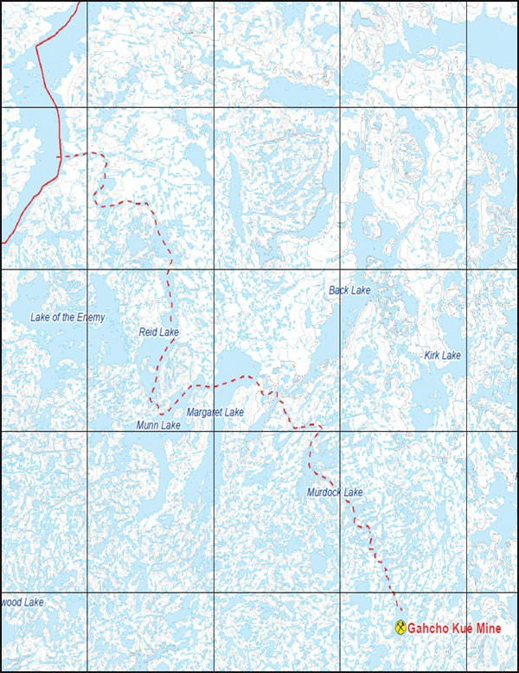
GAHCHO KUÉ SPUR ROAD OVERVIEW
[OFFICIAL]
The Spur road is built and operated by De Beers Canada Inc. and Mountain Province Diamonds, its JV partner, as part of the Gahcho Kué mine’s annual winter road resupply program.
Road access:
- Access to the Spur Road is from the TCWR at approximately KM 295. It begins at MacKay Lake and ends at Kennady Lake near the Mine site.
Spur Road Facts:
-
Distance:
# of portages:
Snowpack on portages:
Target portage width:
Target lake width:
Operating season:
120 km long (approx.)
28 portages (14 km)
>10cm
10 m
40 m
February to March
Road contractor: Nuna Deton’ Cho Winter Road Services JV
Nuna operates the Margaret Lake camp and constructs and maintains the road.
Security: Scarlet Security
- Security personnel monitor the road to ensure the safety of all Road Users’ and compliance to the rules.
-
Signage is placed on MacKay Lake (TCWR) leading up to the junction with the GK Spur Road.
Northbound turnoff signage on TCWR

Slide 19
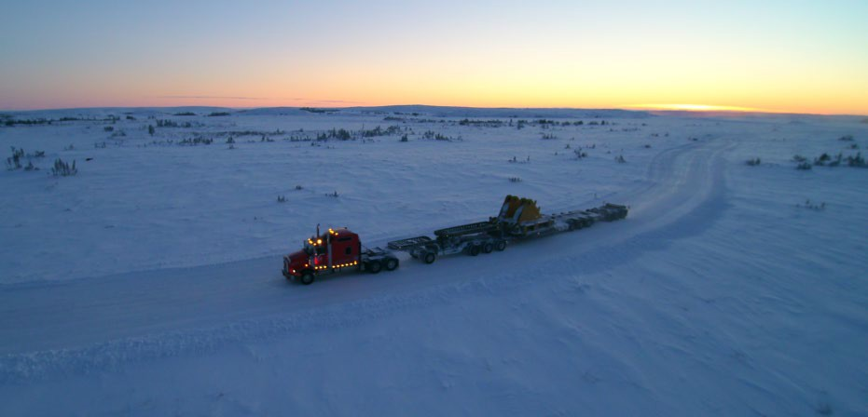
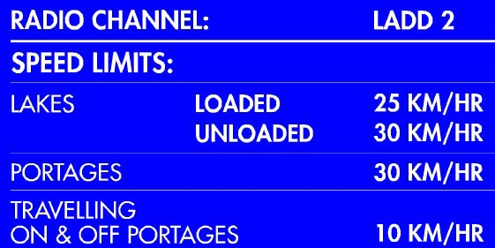
GAHCHO KUÉ SPUR ROAD - RULES
[OFFICIAL]
Radio Communication
‘LADD 2’ is the designated radio communication channel on the Gahcho Kué Spur Road
Travel Speeds
Drivers are required to follow the posted travel speeds while
on the GK Spur Road.
Spacing
Trucks travelling in the same direction must be at least 500 meters apart.
Parking
Do not ‘STOP’ on lakes unless wildlife are on the road, or an Emergency situation occurs
Security
Security can be reach on ‘LADD 2” while on the Spur Road.
35 KM/HR

Slide 20
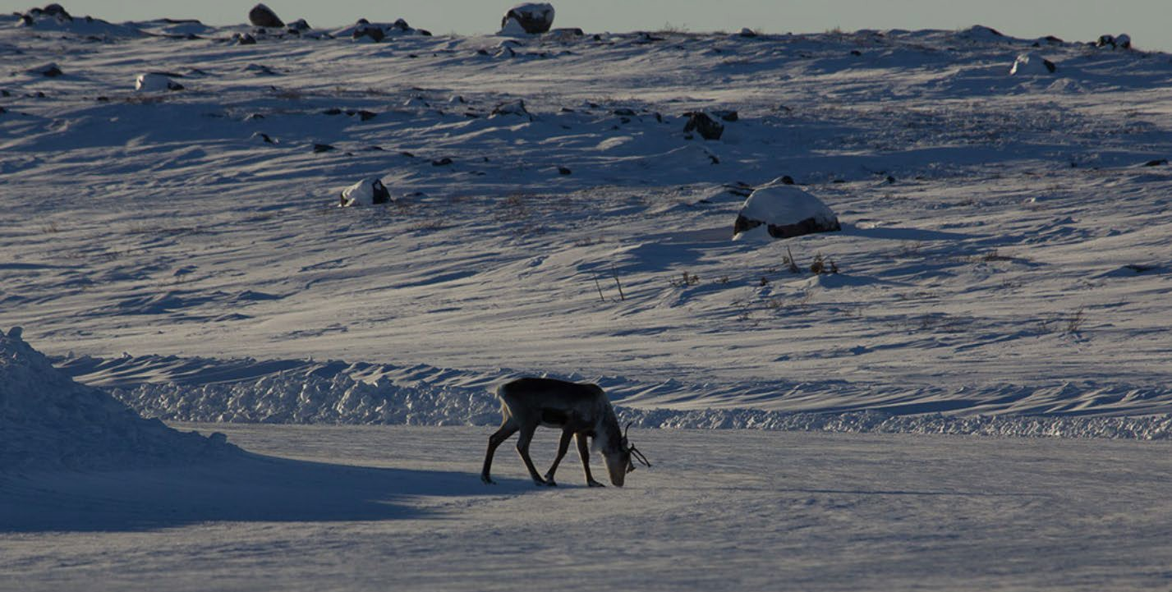
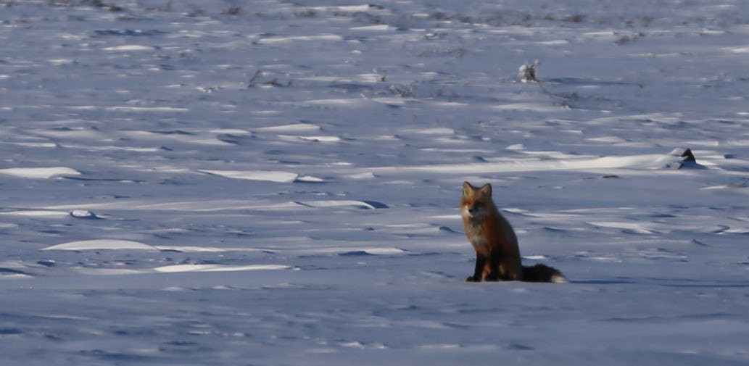
GAHCHO KUÉ SPUR ROAD – WILDLIFE RIGHT-OF-WAY
[OFFICIAL]
Wildlife have the ‘Right-of-Way’
‘STOP’ if it is safe to do so.
If stopped at night due to wildlife presence on the road turn-off bright head lights and leave
low beams or running lights on.
Avoid using the horn.
Remain inside the vehicle.
Wait for wildlife to pass before continuing route at a reduced speed of 10 km/h.
Use a radio to report the presence and location of wildlife, and the parked vehicle to
other Drivers and to ‘Dispatch Office’.
Complete the ‘Wildlife Sightings Log’ form upon arrival at Gahcho Kué or Yellowknife
‘Dispatch Office’.

Slide 21
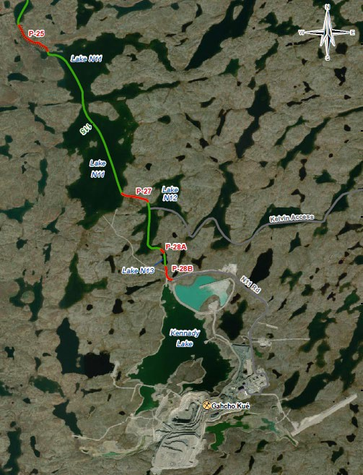
GAHCHO KUÉ SPUR ROAD – ARRIVAL AT THE MINE SITE
[OFFICIAL]
The Driver will Establish contact with ‘GK Dispatch’ at ‘Portage 24’ for incoming loads.
The Lead Driver is requested to have the following information on hand:
Type and short description of their load(s)
Location and estimated time of arrival
Information on any other trucks in their convoy
Drivers are to contact Dispatch when arriving at the Mine Site to coordinate an escort from “the beach” by a Winter Road Marshall.
The Marshall will escort the drivers to Dispatch or another unloading location at site.
Beach
Dispatch
Drivers will notify ‘Dispatch’ when they are ready to leave Site and ensure ‘Dispatch’ acknowledges the correct ‘Truck # and time of departure’
Departing drivers will be escorted to the “beach” by a Winter Road Marshall. Drivers are to call out their driver # once on the ice confirming they have left site.

Slide 22
GAHCHO KUÉ MINE SITE - COVID-19 MEASURES
[OFFICIAL]
Measures are in place to minimize the risks posed by COVID-19 from Winter Road truck travel to site.
Key measures include:
DRIVERS
Will observe all relevant site COVID-19 controls & protocols.
Physical distancing, Mask use and good sanitization practices.
Drivers will be escorted by Site Winter Road Marshalls upon arrival at the mine and up until their departure.
Will sleep in their tractor if they stay overnight while at the mine.
Rooms are available in our Quarantine Dorms on an exceptional basis if required for safety or medical reasons.
No drivers will be permitted to enter the Main camp facilities unless approved, security notified & escorted for medical or safety reasons.
Drivers will have their own dedicated wash car and entrance to Dispatch and the Driver’s Lounge.
The Driver’s lounge will be limited to 10 individuals at any one time with a check-in/out process to ensure compliance.
Enhanced & scheduled cleaning of the Winter Road Dispatch, Lounge & Wash Car Facilities will be completed.
Food will be in individual portions and packaged.

Slide 23
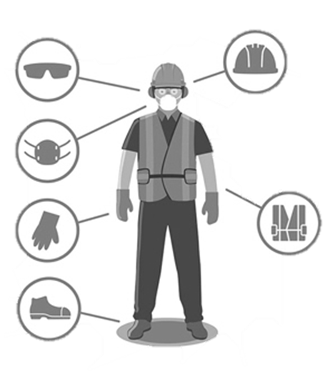
GAHCHO KUÉ MINE SITE – HEALTH & SAFETY
[OFFICIAL]
Drivers MUST always wear PPE when outside their truck while on Site.
Approved PPE includes:
CSA approved ‘Hard Hat’ and liner
CSA approved ‘Steel Toes Work Boots’ warm and insulated
CSA approved ‘Safety Glasses’
‘High Visibility’ apparel
Gloves overlapping coats, - 40 ˚C or better
‘Anti-Slip Ice-Cleats’ for footing.
‘Fall Prevention/Protection’ must be utilized at heights of 2 meters (6.5 feet) or higher:
Let the ‘Off-Loading Crew’ assist with the tie-downs and rigging in instances where a worker would be working over 2 m; they will return it to you.

Slide 24
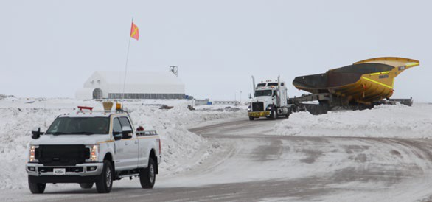
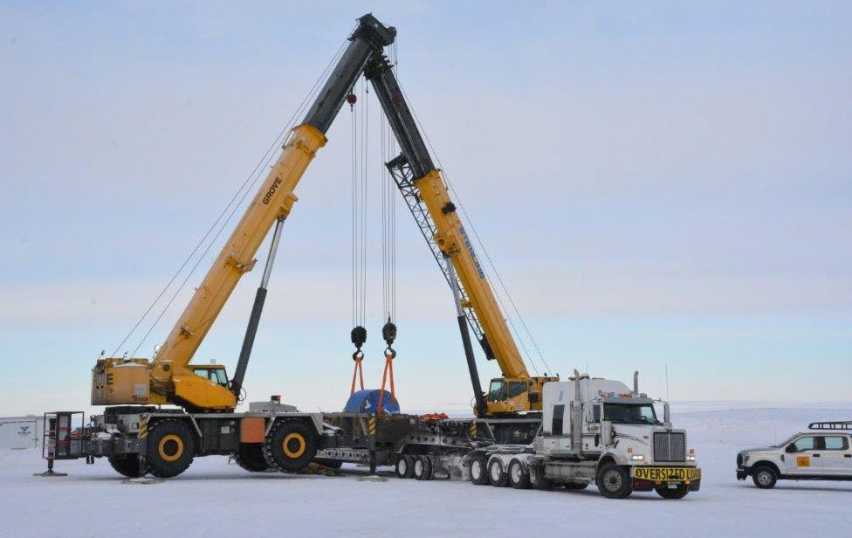
GAHCHO KUÉ MINE SITE – CARGO OFF-LOADING
[OFFICIAL]
The Marshall will meet Drivers at the GK Site entrance or Dispatch Yard location as confirmed by the Dispatcher.
Drivers are not to proceed beyond the Dispatch yard without a Marshall to escort them to their offloading location.
The Marshall will direct Drivers to their specific off-loading point and collect paperwork for ‘Dispatch.
Drivers will (with assistance from the ‘Off-Loading Crew’ if required), prepare the load to be handled and remove straps and tie-downs.
Drivers are required to follow directions from the ‘Marshall’ or the De Beers Supply Chain Team when it pertains to location for off- load, Safety & Environmental requirements or Emergency Response (ER).
‘Dispatch’ will arrange for any back-haul material with the Driver.
Drivers are responsible for securing any back-haul loads with assistance from the ‘Off-Loading Crew’ if required.
If a truck is parked with the Driver out of the vehicle – wheel chocks must be used.
7

Slide 25
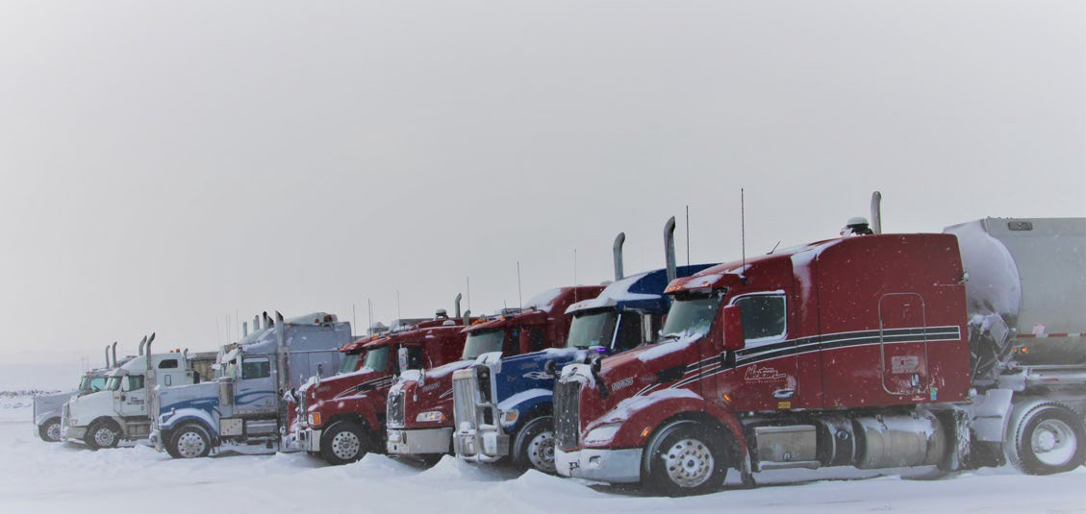
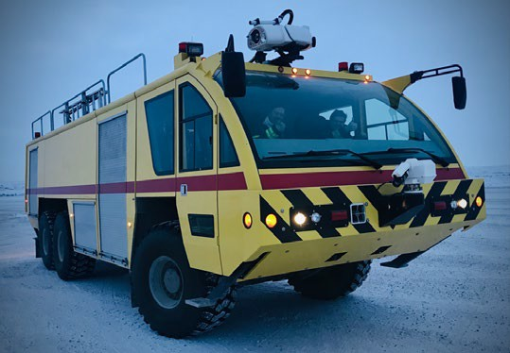
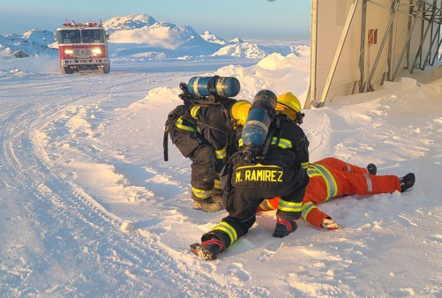
GAHCHO KUÉ MINE SITE – WEATHER EVENTS & EMERGENCY RESPONSE
[OFFICIAL]
REDUCED VISIBILITY
‘Extreme Winter Conditions’ may cause ‘White-Out’ (WO) conditions. When WO conditions occur, work will be suspended until the WO situation has ended.
This situation will be communicated to all personnel on Site and will apply to the truck drivers as well.
Site activities are restricted when visibility is reduced to 300 meters or less, as reduced visibility may hinder the ability to evacuate injured personnel off-site .
EMERGENCY RESPONSE (ER)
On Site:
The Site ‘Emergency Response’ (ER) will be communicated over all radio frequencies and directions given on which protocols or procedures are to be initiated.
There is to be no radio ‘Chatter’ until the ‘Stand Down’ call is communicated.
Off-site:
Drivers are to follow their Company’s ‘Winter Road Response Plan’

Slide 26
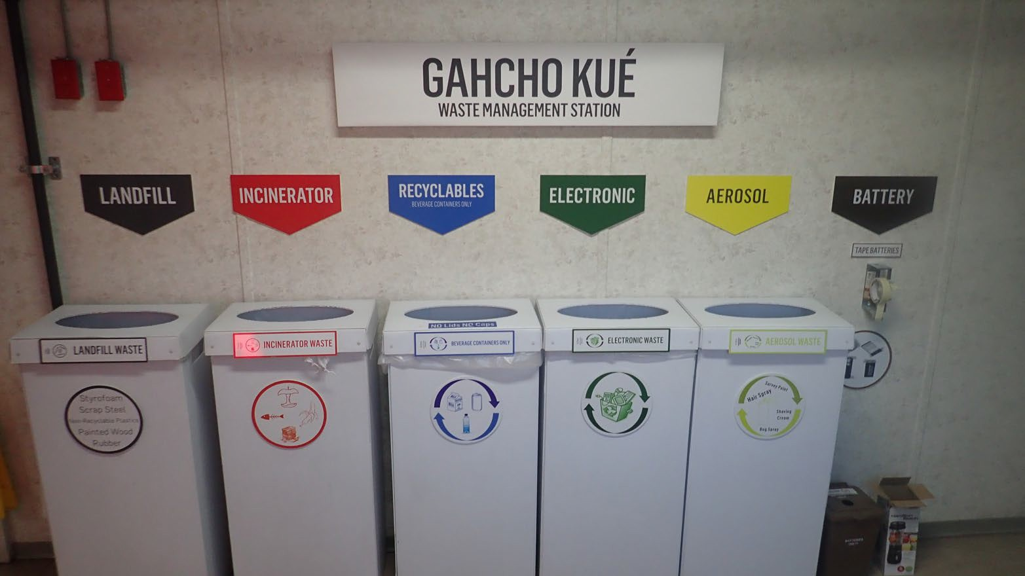
GAHCHO KUÉ MINE SITE – WASTE MANAGEMENT
[OFFICIAL]
DOMESTIC WASTE
Do not litter
Food waste must remain inside vehicles or buildings
Do not place any light materials or food in truck boxes
HAZARDOUS WASTE
Oily rags, soiled drip trays, gylcol or any other hydrocarbon waste must be segregated from other waste
Bring hydrocarbon waste to the ‘Dispatch Office’ and deposit in ‘Hydrocarbon Waste Drum’
WASTE RECEPTACLES are LOCATED at:
Drivers’ ‘Facilities & Rest Area’ at Gahcho Kué Site
The ‘Off-Loading Crew’ can also assist if the off-load area does not have appropriate receptacle

Slide 27
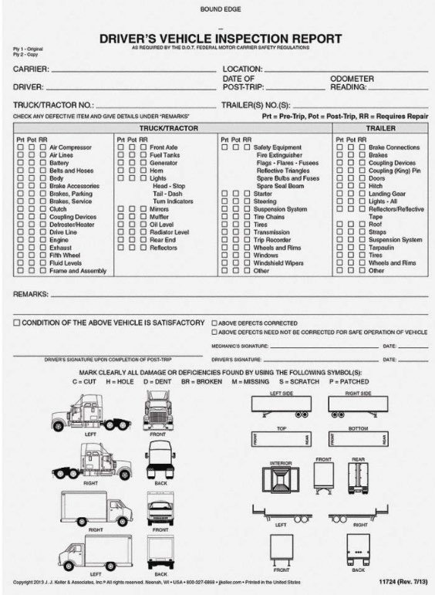
GAHCHO KUÉ MINE SITE – SPILL PREVENTION
[OFFICIAL]
SPILL PREVENTION
‘Spill Prevention’ is an important component of managing environmental risks on the Winter Road. If we can prevent a spill from occurring, we eliminate the potential for harming the environment.
Conduct Pre-Op Inspections of Your Vehicle:
Regular vehicle inspections are the most effective means of preventing spills. Make sure you check under your vehicle for leaks, inspect hoses and connections where possible, and monitor fluid levels regularly.
Do Not Operate ‘Leaky’ Vehicles: Vehicles that show signs of drips or leaks MUST NOT BE OPERATED until the source of the leak has been determined and repaired.
Spill Kits/Absorbents:
Vehicles must be equipped with spill absorbents. Although spill kits can’t prevent spills, they can improve response time and minimize the impact of spills on the environment.
Spill trays are to be used while vehicles are parked.

Slide 28
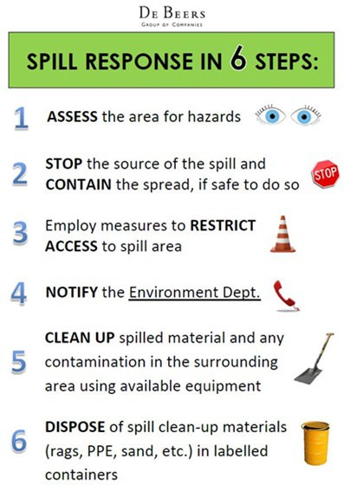
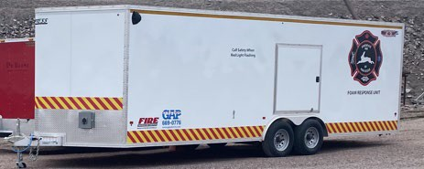
GAHCHO KUÉ MINE SITE – SPILL CLEAN-UP / REMEDIATION
[OFFICIAL]
SPILL CLEAN-UP / REMEDIATION
Spills must be completely cleaned-up as soon as possible after they occur:
If your vehicle is involved in a spill, you are responsible for initiating a clean-up immediately. If you require assistance with the clean-up, please let ‘Dispatch’ know when you call to report the spill, and they will coordinate assistance.
Spill response equipment, including an emergency response trailer and spill absorbents, are located at both the Gahcho Kué Site and at the Margaret Lake construction contractor’s Camp.
Winter Road Security will have spill response equipment in their vehicles.
Contaminated snow and ice must be disposed at the Gahcho Kué Site or with your Company’s Dispatch.

Slide 29
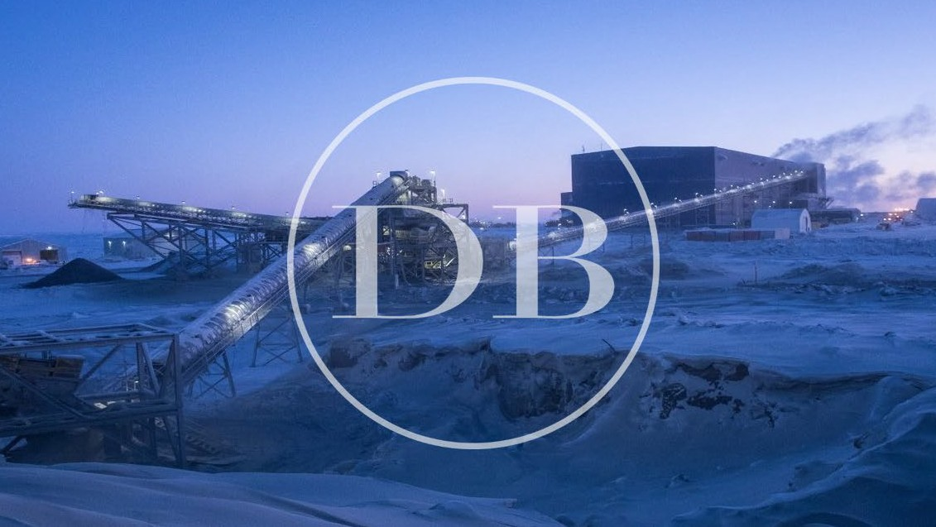
[OFFICIAL]

