Slide 1
2024 Winter Road Driver’s orientation
SAFETY IS THE ENGINE AND YOU ARE THE KEY THAT STARTS IT

Slide 2
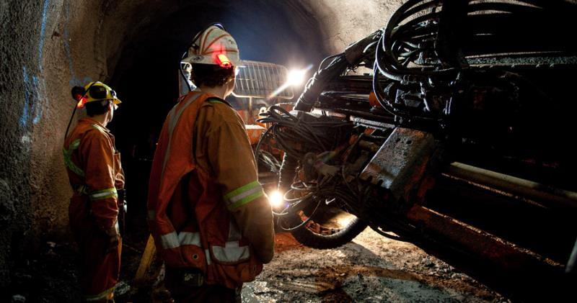
agenda
01
Ekati
02
Safety Expectations
03
Winter Road Dispatch Requirements
04
Misery Road Rules
05
Paul Lake Bridges Rules

Slide 3
01
Getting to Ekati

Slide 4
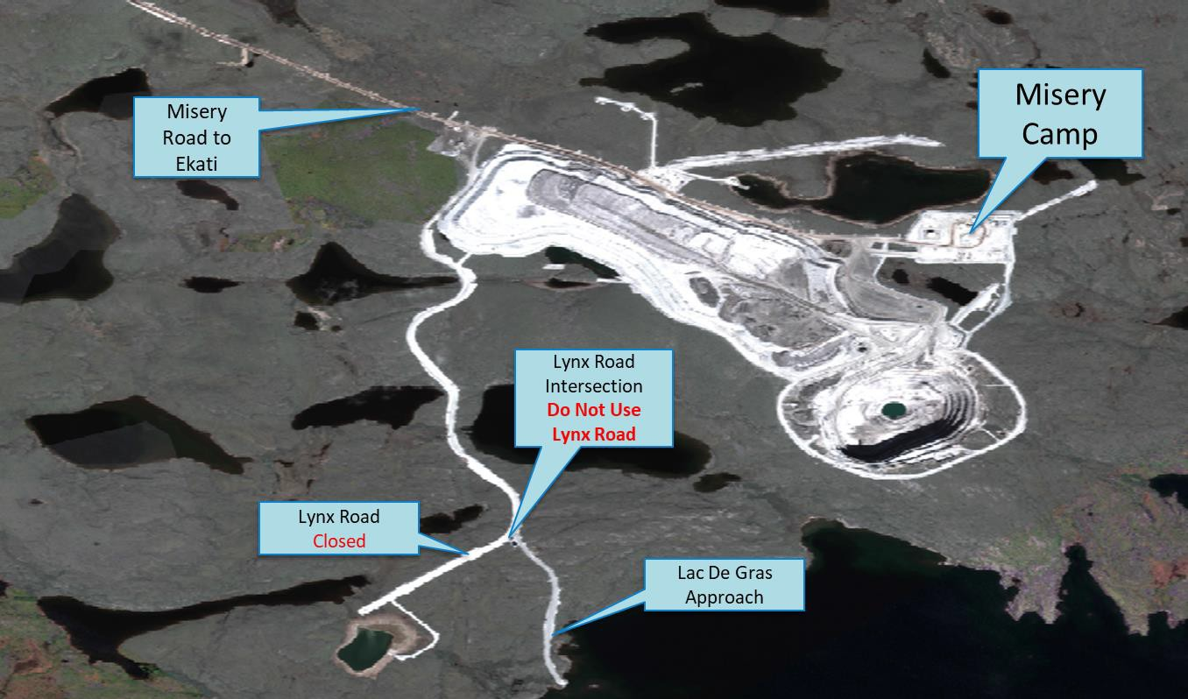
Getting to ekati via the misery haul road
2023 Winter Road Driver’s Orientation – Entering the Property

Slide 5
GETTING TO EKATI MAIN CAMP
2023 Winter Road Driver’s Orientation

Slide 6
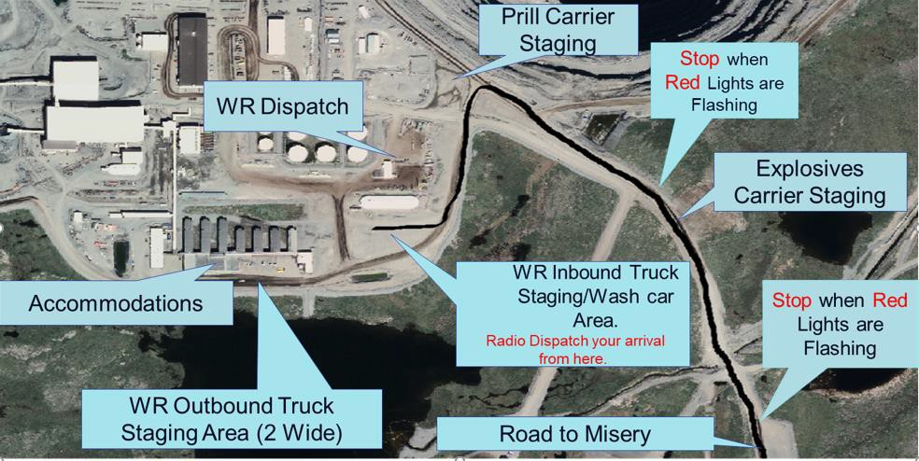
Ekati camp layout
2023 Winter Road Driver’s Orientation – Entering the Property

Slide 7
02
Safety Expectations

Slide 8
SAFETY EXPECTATIONS AND SITE RULES
2023 Winter Road Driver’s Orientation
Outbound or inbound trucks must park in the designated areas.
Once exiting the vehicle, you must wear your PPE including, hard hat, reflective vest, gloves, safety glasses/goggles, steel toes and especially ice grips on boots and winter gear.
All drivers are to maintain a copy of the personal safety card (PSC) with them and make it available for review upon request by any Burgundy representative. This card will be provided to each driver on their first trip to site and must remain with you for the rest of the 2023 Winter Road season. If you lose it, please make sure to ask for a replacement right away.
Chock your vehicle if you are not behind the wheel. Use ‘true’ wheel chock blocks only, no rocks or logs. Wheel Chocks must be placed snuggly under the tractor tires.
All garbage from trucks must be disposed of in the proper waste bins.
All spills which include coffee, pop, juice, etc. must be reported to Dispatch immediately upon detection. Do not pour your liquids on the ground.
Security will be always present and may conduct Security/Safety checks at any time.
Any Winter Road Truck drivers not following these important safety rules may lose their Safety Incentive Bonus for that trip. Repeat offenders may be banned from Ekati.
Absolutely no drugs or alcohol on the property. No unauthorized photography or videography.
Report to Dispatch immediately upon arrival at Lac de Gras/Lynx intersection.
If possible, and if our crews are available, we will load off Misery materials prior to reporting to Ekati Main Camp.
Upon arrival at the Winter Road Inbound Truck Staging Area, all drivers will radio the dispatchers. You will then be provided direction by the dispatchers to wait for an escort vehicle or they will direct you where you need to go on the property if you have already been to site and know where you are going.
NEVER enter haul roads, except for Misery Road, without positive radio communications AND an escort.
Follow all road signs and adhere to all traffic lights. Both North and South Bound trucks must stop at red flashing lights on Misery Road near the end of the runway when flashing.
Prill carriers will be staged below Waste Management, not with diesel carriers

Slide 9
DRUGS & ALCHOHOL AT EKATI-CANNABIS ALERT
2024 Winter Road Driver’s Orientation
With the legalization of Cannabis, Ekati will be taking a NO TOLERANCE stance. Ekati reserves the right to investigate any situation when there are reasonable grounds to believe that banned substances or products, including drug paraphernalia are present on company premises.
Drivers that display or are suspected of using, possessing or transporting Cannabis or any Drugs or alcohol will be investigated by the Ekati Security Department and could result in a lifetime ban from coming to Ekati. This may also result in being banned from driving on the Tibbitt to Contwoyto Winter Road as well.
We must ensure that all Ekati employees and all WR Truck Drivers have a safe, healthy and productive environment in which to work.

Slide 10
03
Winter Road Dispatch Requirements

Slide 11
ARRIVING AT EKATI’S WR DISPATCH
2024 Winter Road Driver’s Orientation
The following applies to ALL trucks arriving at the Winter Road (WR):
Once arriving at the WR Inbound Truck Staging Area, you must contact dispatch via radio. On your first trip to site, you will then be directed to wait for an escort who will escort you to the WR Dispatch building. On your second time to site and going forward you will be directed by the dispatchers to drive to the WR Dispatch building on your own. There will be a process by which the drivers are informed to remain in their vehicles until they are informed to proceed to trailer for check-in to ensure only one driver enters the WR Dispatch building at a time. You will then physically enter the WR Dispatch building which will be retro fitted with plexi-glass for an additional barrier between driver and the dispatcher in order to register your truck number and allow Dispatch to meet you to take your information. You must wear your PPE whenever you leave your vehicle.
All drivers must obtain a PSC card on their first visit to the WR Dispatch Building. This card must be reviewed and filled out appropriately. This card will then be expected to be in your possession for the rest of the WR season with the expectation that it is reviewed before and during each trip to Ekati. If you lose this card, you must obtain another one before proceeding past the WR Dispatch Building. When approached by Safety or Security officers, you may be asked to present your card and be prepared to discuss its contents.
When released by Dispatch, Drivers can return to their trucks and must conduct a visual safety check of their engines for leaks or
anything that could pose a fire risk.
The following is applicable to all Prill carriers:
All Prill carriers must stop outside the AN building and will conduct a visual safety check of their engines for leaks or anything that could pose a fire risk before entering the AN building.
While the truck is being unloaded, the driver of the truck will remain on Firewatch only and will be expected not to help with the actual unloading of the Prill.

Slide 12
PARKING PROCESS AND WASHCAR ACCESS
2024 Winter Road Driver’s Orientation
The following applies to ALL trucks arriving at the WR :
If required, Drivers will be permitted to sleep at the Inbound Truck Staging Area or the Outbound Staging Area, but only if it is determined that you can travel no further. Drivers will not have access to the Misery Camp and must travel to Ekati to access the wash car and rest. Parking will be limited.
Any driver that is deemed to be tired and needing rest will be directed by Security or the Dispatchers on how much rest time you must take before you will be dispatched to leave site. The rest times are mandatory and must be adhered to.
All Winter Road trucks that park outside of the accommodation building must park in an "offset" manner as per the diagram shown below.
Access to Ekati main camp has been reinstated strictly for dine in or take out only during meal service hours. Breakfast: 4:30 am to 8:00 am, Lunch: 12:00pm to 1 pm, Supper: 4:30 p.m. to 8:00 p.m. The lunchroom will be open 24hrs for self-take-out. In the event of severe weather where it necessary to provide safe resting area, Ekati will have a designated isolation accommodation wing with rear-door access only which will allow for segregation of our workforce and the drivers.

Slide 13
MISERY/LYNX ROAD & PAUL LAKE BRIDGE RULES
2023 Winter Road Driver’s Orientation
The following applies to ALL trucks arriving at the WR:
While travelling on Misery Road you must call in the road kilometer signs, direction of travel and type of vehicle or equipment, (Example: “Super B 102, northbound, km 5”).
Misery Road is an active mining road at Ekati. Due to periodic Haul Truck operation on Misery Road, this may require the road to be temporarily closed to Winter Road traffic. A “Guard Vehicle” will control access to the Misery Road during closure. Do not pass the point of closure (intersection leading to Ekati or Misery) unless directed by the “Misery Road Closure Guard”. These closures are necessary to guarantee the highest level of safety. The closures will be of relatively short duration and will be announced on the Lad1.
Winter Road Trucks must never pass any form of moving Haul Trucks on the Misery haul road. When passing a parked Haul Truck, Driver must contact the driver of that Haul Truck by radio and must receive verbal approval to pass.
Winter Road Trucks that need to pass any slow moving supporting Heavy Equipment, Driver must contact the driver of that piece of equipment by radio and must receive verbal approval to pass.
When approaching a crew bus (blue flashing light), all Winter Road Trucks must find a safe area to stop as soon as safely possible, avoiding narrow road sections, inclines, and blind turns. Any light vehicles following a Winter Road Truck must also pull over and must never pass the stopped Winter Road Truck. The Winter Road Truck and any light vehicles that are stopped must wait for the crew bus to pass by before resuming travel.

Slide 14
MISERY/LYNX ROAD & PAUL LAKE BRIDGE RULES cont.
2023 Winter Road Driver’s Orientation
Please adhere to the following
Paul Lake Bridge Single Traffic Rules:
Single lane traffic.
20 km/h at both North and South approaches to the bridge.
Crew buses will yield “Right of Way” at the bridge and stop (similar to an uncontrolled railway crossing.)
All North bound traffic has the “Right of Way” except the crew bus.
DO NOT PASS THE ROADTRAIN!

Slide 15
End slide: enter contact information

